Slide 1



Corpus development of endangered languages and its application using NLP
Satya Ranjan Dash
Associate Professor
School of Computer Applications, KIIT University , India

Slide 2
Agenda
Introduction
Facts about the Languages
Overview
Need for Language Resource
Corpus
Role of AI in Language Resource Development
Applications of NLP
Conclusion

Slide 3
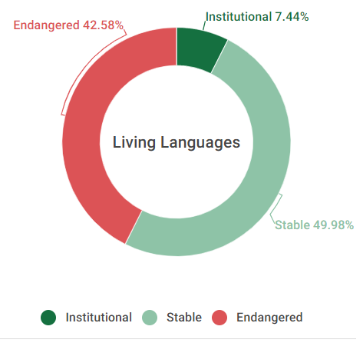
Introduction ^{(1/2)}
Language is the vehicle of our culture, yet 43 percent of the global languages are endangered.
UNESCO offers a classification system to show how languages are 'in trouble'.
It has categorised 5-scale classification system such as: vulnerable, definitely endangered, severely endangered, critically endangered & extinct.
Apart from this, 2011 census has also revealed that 123 languages are present in India grouped in 2 categories.
Image Source: https://www.ethnologue.com/guides/how-many-languages-endangered

Slide 4
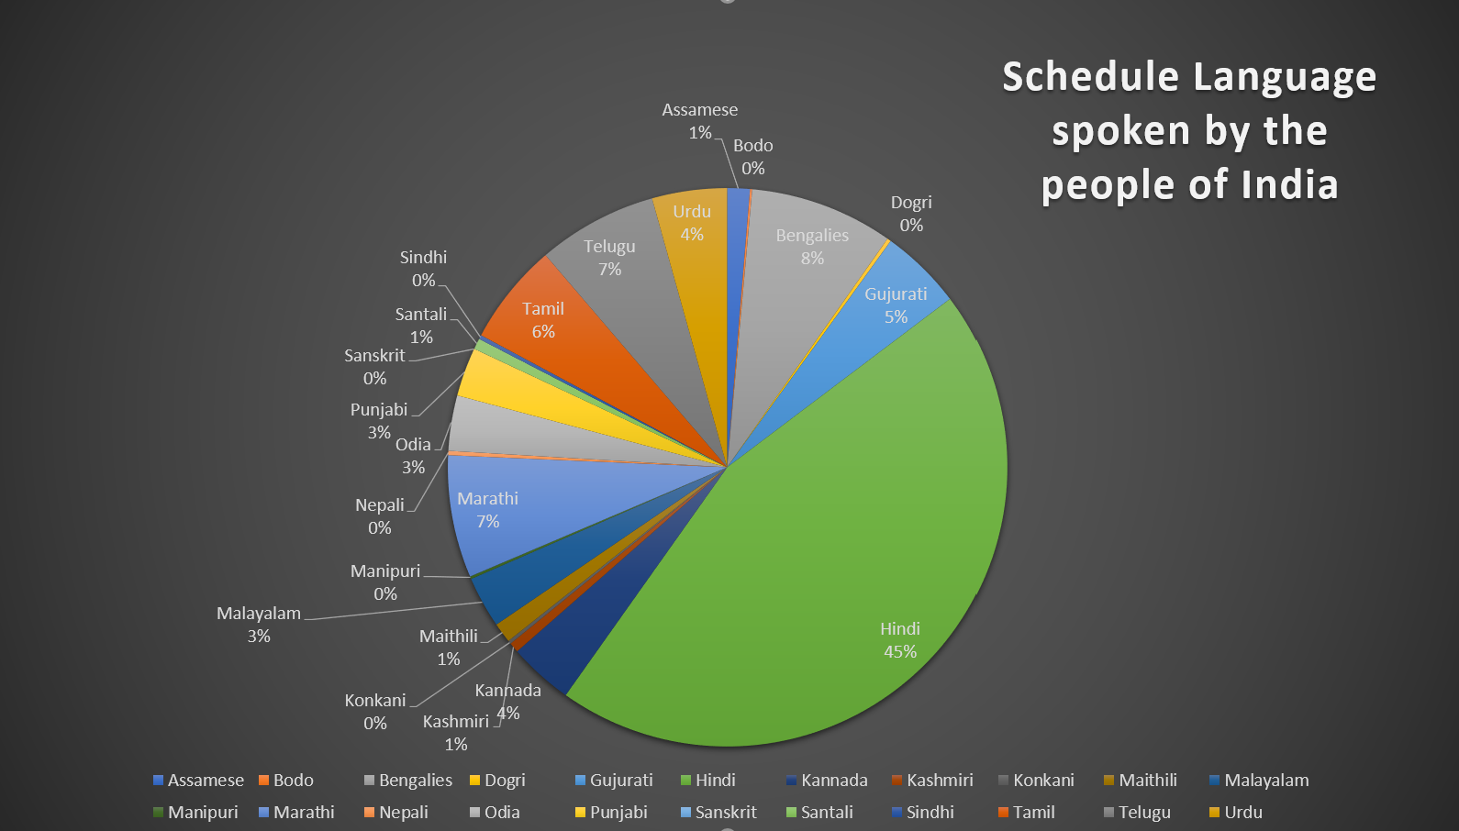
Introduction ^{(2/2)}
The first category is schedule languages and the second category is non-schedule languages, which has 22 and 100 languages respectively.
A staggering 96.71% of the speakers are from the Schedule language category, whereas 3.29% speakers are from the non-schedule language category.
It is important to note here that, these 3.29% speak a whole lot of 100 types of languages with numerous varieties of dialects shown in Fig1.
Fig 1: Shows the percentage of people speaks schedule language in India.

Slide 5
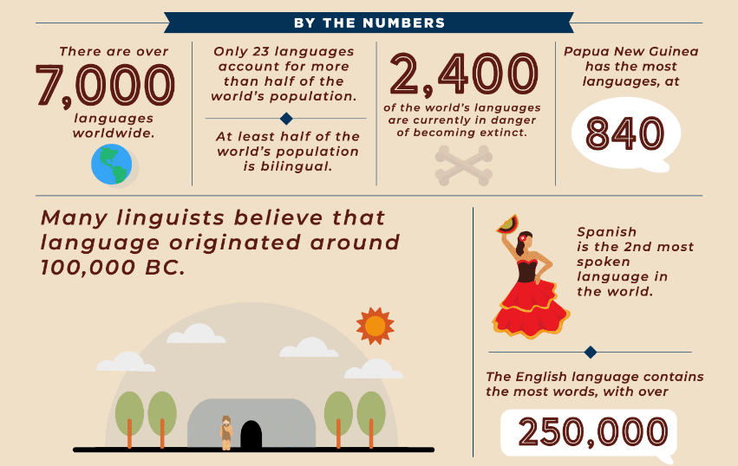
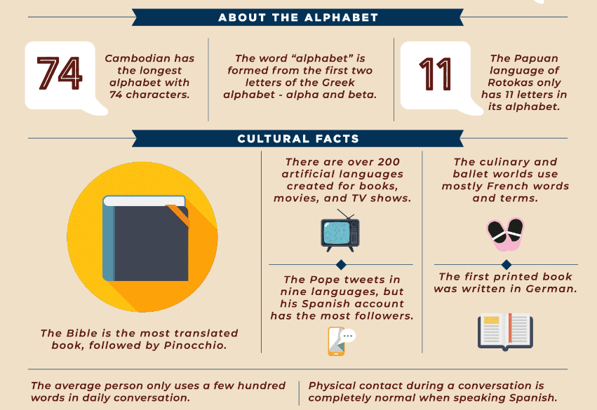
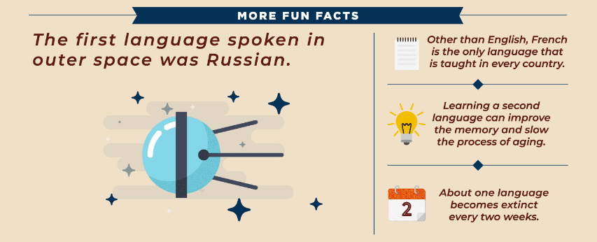
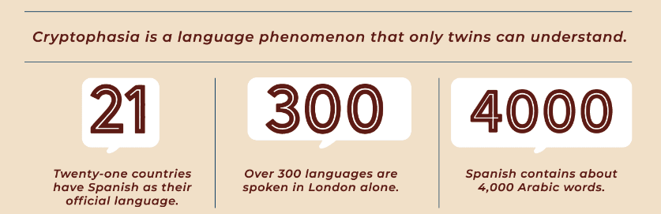
Facts about Languages
Source: https://takelessons.com/blog/language-facts-z14

Slide 6
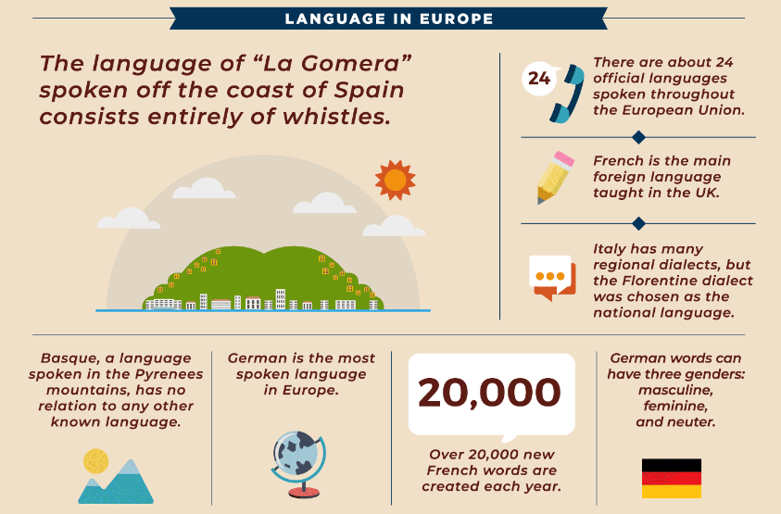
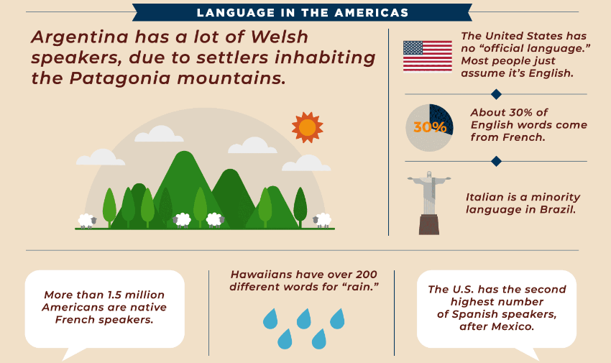
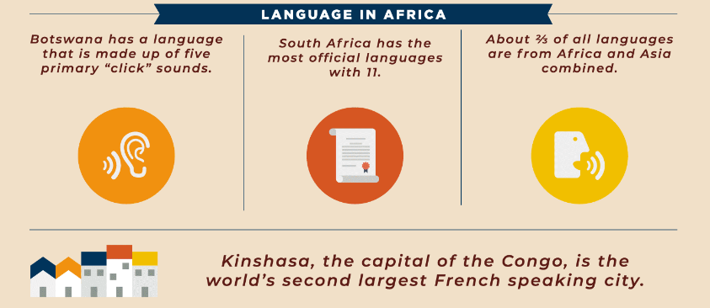
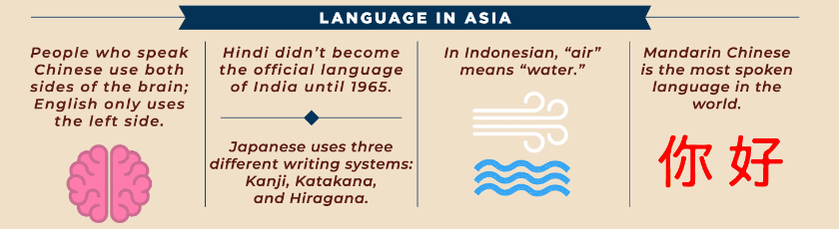
Facts about Languages
Source: https://takelessons.com/blog/language-facts-z14

Slide 7
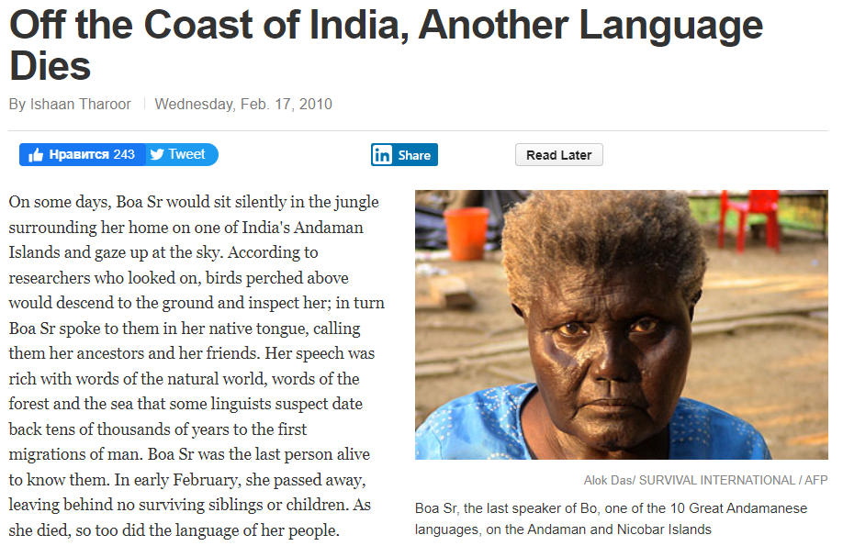
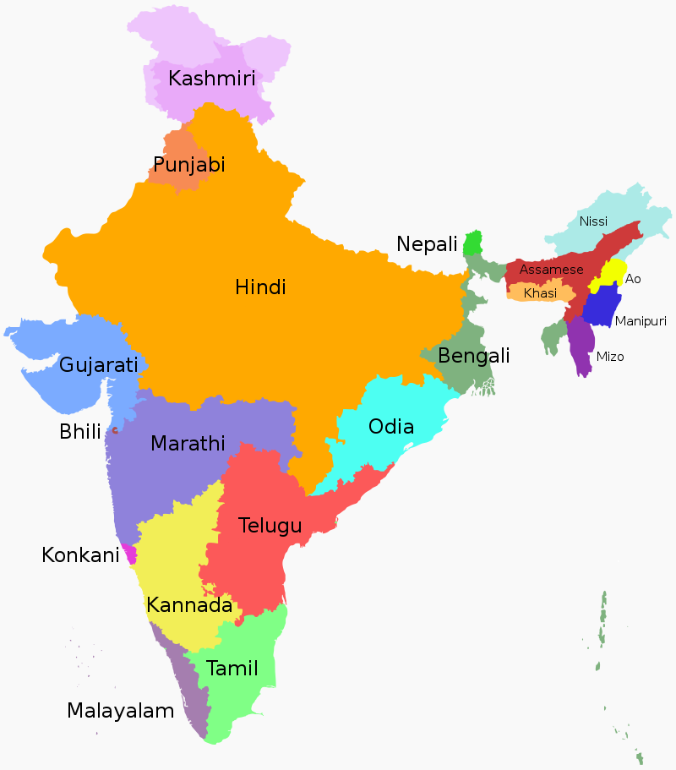
Facts about Languages
source: http://content.time.com/time/world/article/0,8599,1964610,00.html
Image source: https://en.wikipedia.org/wiki/List_of_languages_by_number_of_native_speakers_in_India#/media/File:Language_region_maps_of_India.svg
Boa Sr (circa 2 January 1925 – 26 January 2010) was an Indian Great Andamanese elder. She was the last person fluent in the Aka-Bo language.

Slide 8
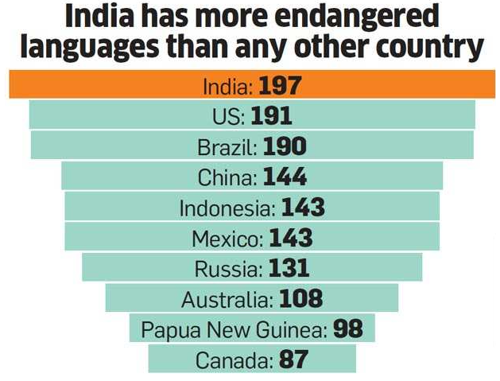
Facts about Languages
One language dies every 14 days.
Linguists estimate that of the world’s approximately 6,900 languages, more than half are at risk of dying out by the end of the 21st century.
Most languages, though, die out gradually as successive generations of speakers become bilingual and then begin to lose proficiency in their traditional languages.
At least 400 Indian languages are at the risk of dying in coming 50 years.

Slide 9
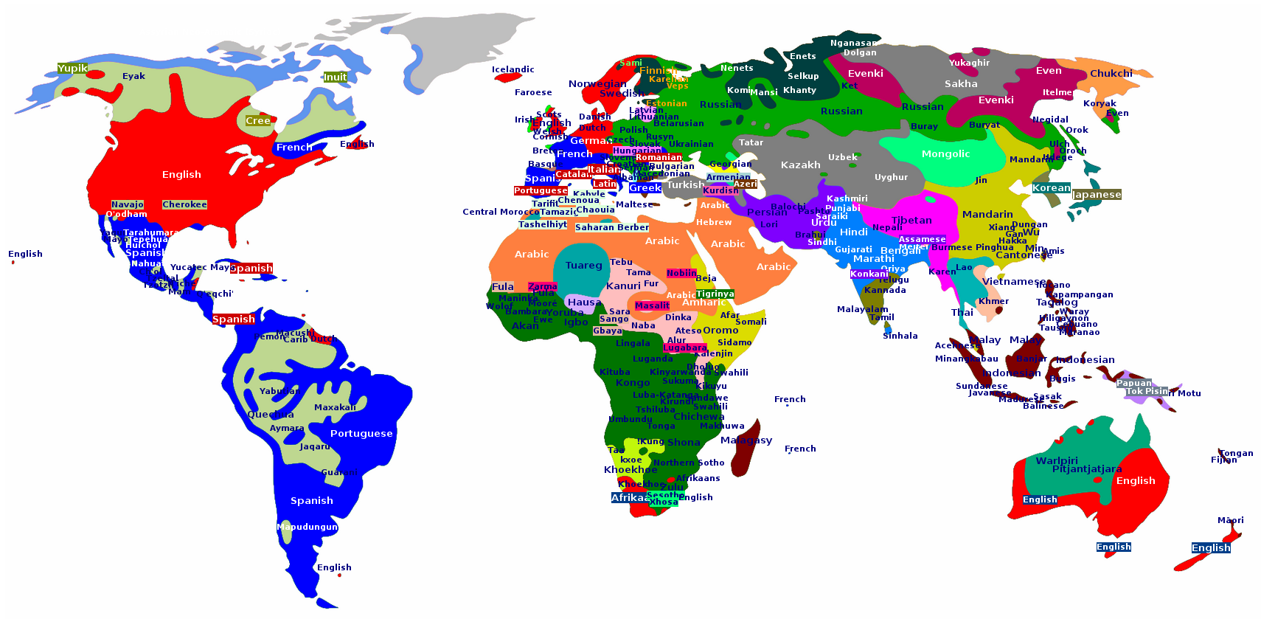
Overview
The ethnologue.com website lists over 7000 languages in the world.

Slide 10

Overview
However, merely 1000 out of an overall 7000 languages worldwide are supported online.
As per UNESCO, by the end of the century, around half of the languages spoken today could disappear.
The internet, which is now the primary way of sharing information, has a key role to play in promoting multilingualism.
Internet is dominated by English and some other widely spoken languages such as Spanish and Chinese. This indicates that nearly 88% of the world's languages have either insignificant or no presence on the internet.

Slide 11
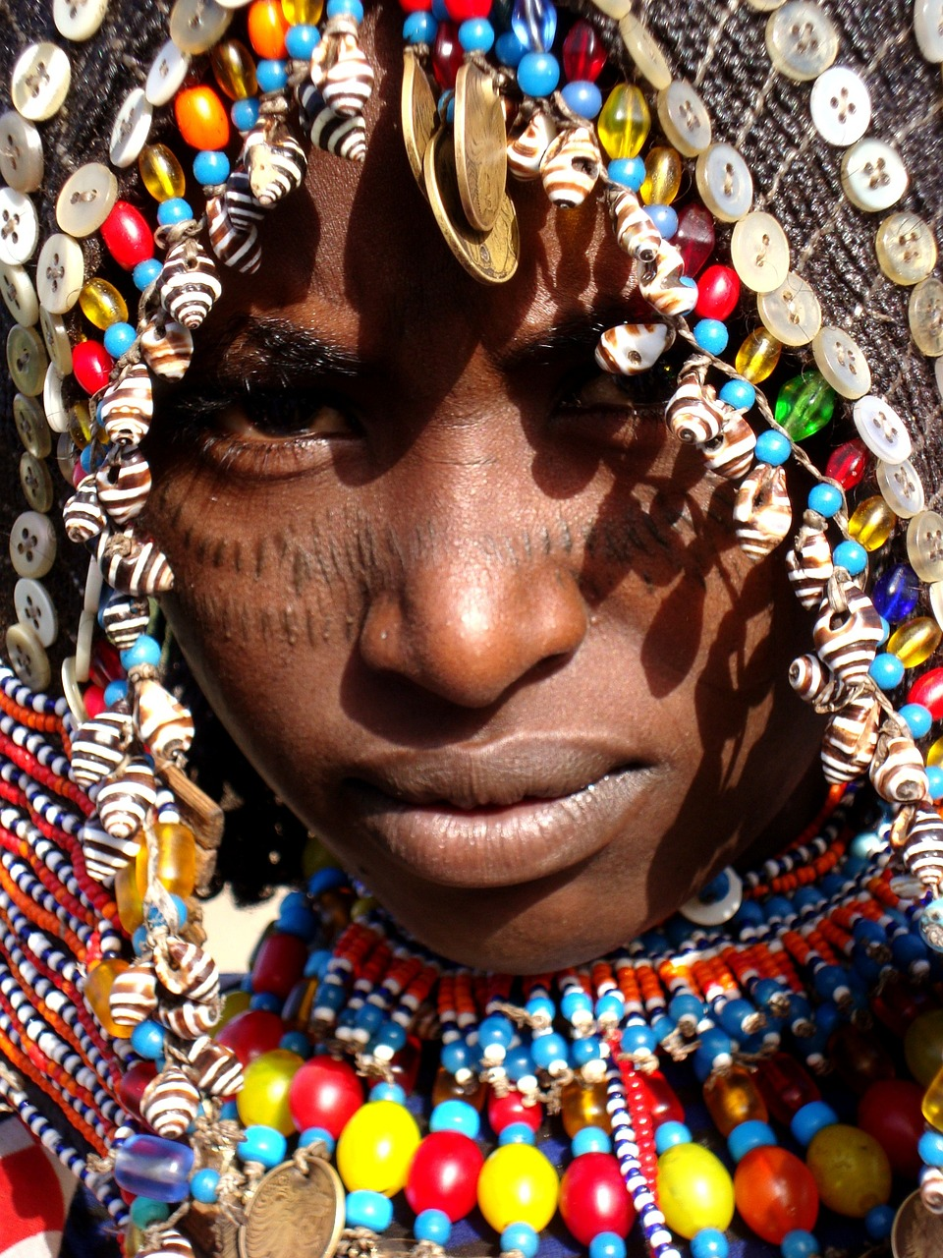
Overview
Absence of digital representation of indigenous dialects/non-written languages may result in the loss of precious heritage that has immense value for the future generations.
About 1.2 billion people, or 20% of the world's population, can't use their own language to navigate the digital world.
a scarcity of resources, tools, and technologies is causing the respective communities to lag in accessing technologies and services, resulting in their speakers failing to connect to the digital world.

Slide 12
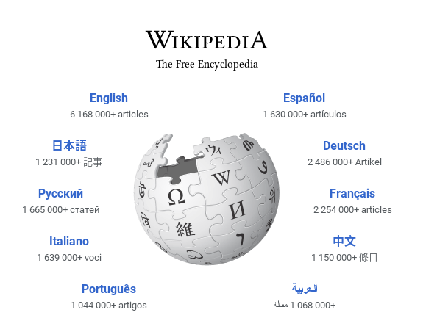
Need for Language Resource
Wikipedia has texts in 313 languages.
Natural language technology development depends on large numbers of language resources (text / speech).
Lack of language resources affects the development of natural language technologies.

Slide 13
Corpus
Corpus (plural: corpora) is a term from the field of linguistics and refers to a large set of texts (usually in electronic format) which is considered to be representative of a language (or language variety, to be more precise) and is used to analyze it.
A corpus may be quite small, for example, containing only 50,000 words of text, or very large, containing many millions of words.
It provides us with quantitative data that is used to build NLP applications.

Slide 14
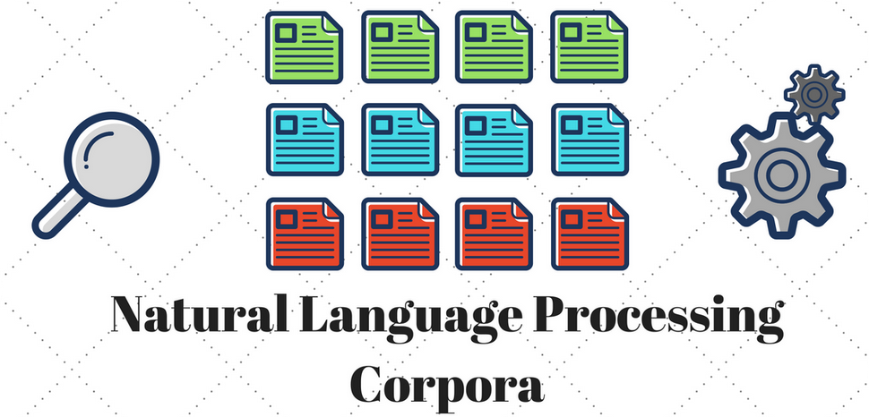
Role of AI in Language Resource Development
Digitization
Data collection and Corpus Development
Tools and Technologies
NLP, OCR, Speech-To-Text Engine, Generative AI

Slide 15
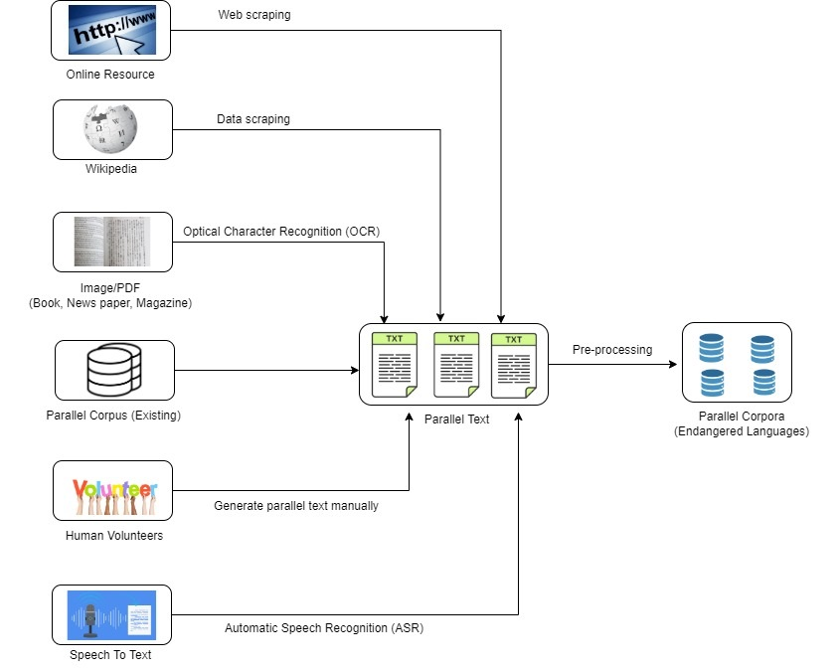
Proposed Model^{(1/2)}
The present work is trying to address these above said gaps by developing a model where we are adopting a 6 layered data gathering process with a complete guideline for classifying languages and collecting corpus considering language diversity, style and achievable issues shown in Fig 2.
Fig 2: Proposed model to prepare the parallel corpora

Slide 16
Proposed Model ^{(2/2)}
Web Scraping from Online Resources
Web scraping would be essential for collecting large amounts of data from the online resources and this data could be unstructured and in HTML format.
Data Scraping from Wikipedia
Data Scraping from Wikipedia would be another source for creating text dataset for low-resource and endangered languages.
Optical Character Recognition
The images of textbook, storybook, magazine, newspaper, article, blogs, and other printed sources would be fed into OCR for extracting data
Parallel Corpus
Parallel corpus in this context is existing dataset or corpora available for the low-resource language
Human Volunteers
Human Volunteers or the community should be taken into the data collection phase as they can input text data on their own.
Automatic Speech Recognition
ASR can be defined as process of collecting data as speech data and converting it into text data.

Slide 17
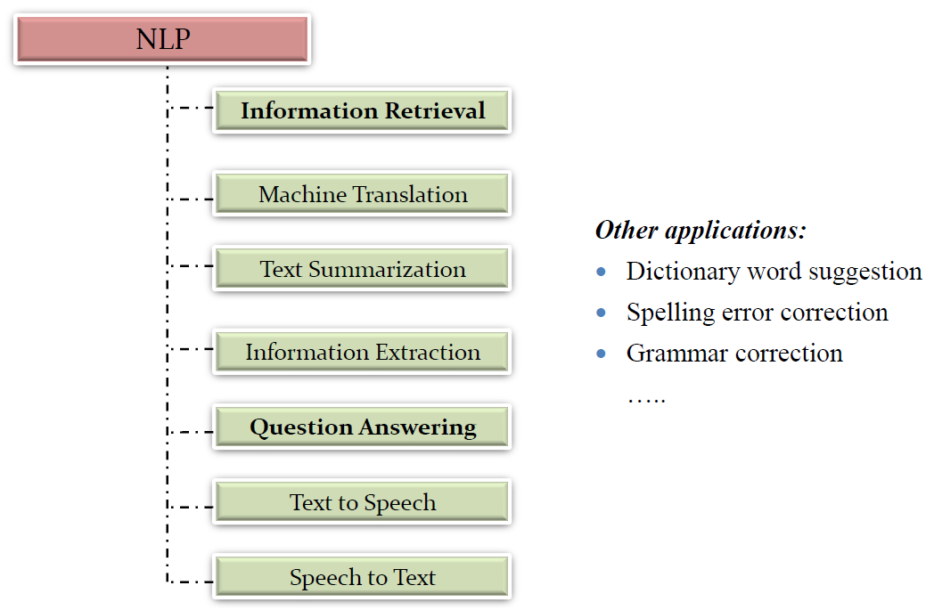
Applications of NLP

Slide 18
Natural language Generation with Generative AI and LLM
The NLG sub-section of NLP uses artificial intelligence to create stories from the data.
NLG has six stages:
Content analysis,
Data analysis,
Document structure,
Sentence alignment,
Grammatical structure,
Language presentation.
Data filtering by identifying the key topics to include at the process's end.
Machine learning is used to interpret and understand data. Based on the kind of data interpreted, a written plan is created.

Slide 19
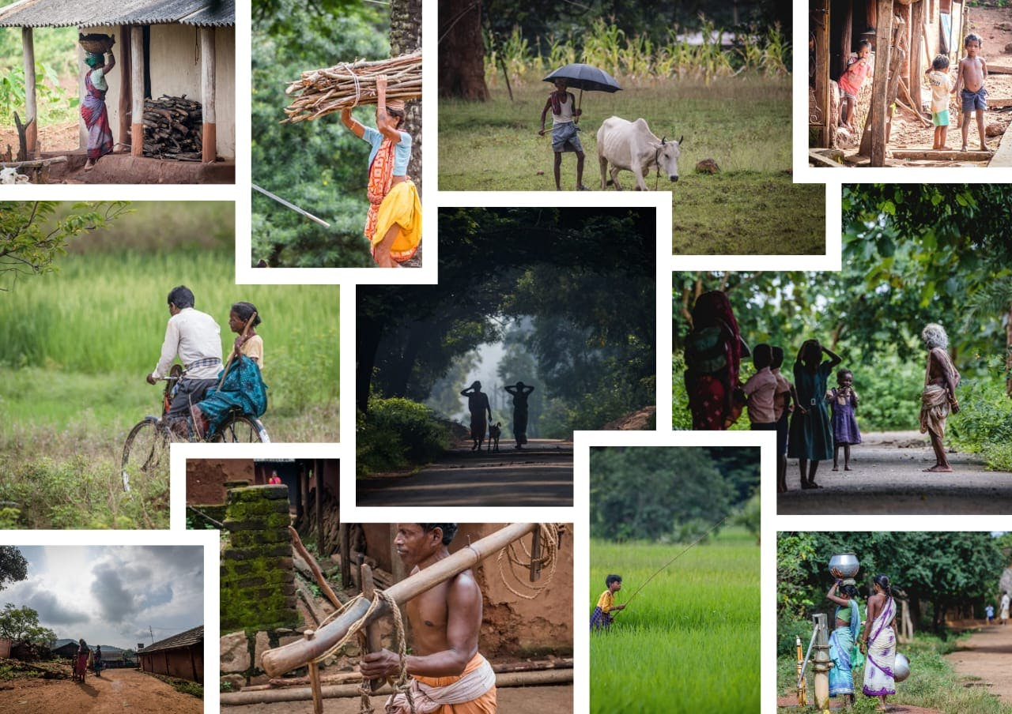
Our Repository KILR
KALINGA INDIGENOUS LANGUAGE REPOSITORY(KILR). https://ilr.manishmh.vercel.app/
KISS & KIIT's Indigenous Language Repository(A Digital Tapestry of Rich Heritage).
Will be functional from 9th August 2024.

Slide 20
Conclusion
This proposed model can conclude that all primary low-resource language sources are considered for making this parallel corpus.
The collection of speech data and convert it into text dataset would be a bigger challenge in this research context.
Web scraping, OCR-based text data extraction from online and printed sources respectively would be effortless and automated.
These techniques could be faster compared to ASR-based text data collection.
Human volunteers can contribute to the parallel corpora in suitable way and their manual data entry would take longer duration.
Speech to Speech Dialect identification can be done through ASR.
However, the noise reduction in ASR would be primary concern in the implementation.

Slide 21
Publications
Cross-Lingual Transfer Learning for Bambara Leveraging Resources From Other Languages.
Named Entity Recognition (NER) in Low Resource Languages of Ho
Automatic Language Detection for Low Resource Ho Language.
Automatic Extractive text Summarization for Ho Language
A Systematic Review on Automatic Speech Recognition for Odia Language
LLM Fine-Tuning for Low Resource Language: A Case Study on Odia
Olive: An Instruction Following LLaMA Model For Odia Language
Generative Chatbot Adaptation for Odia Language: A Critical Evaluation
Extractive Summarization on Twi Language Using Text-Rank and Fuzzy Clustering Algorithm
Automatic language identification: a case study of Pahari
Amharic ATS -A Comparison Between Graph Based and Statistical Based Approach using Rouge Metric and Human Evaluation
Universal Dependency Treebank for Ho Language
MDOLC: Multi Dialect Odia Song Lyric Corpus
Role of NLP for Corpus Development of Endangered Languages
Hausa Visual Genome: A Dataset for Multi-Modal English to Hausa Machine Translation Bengali Visual Genome: A Multimodal Dataset for Machine Translation and Image Captioning
BertOdia: BERT Pre-training for Low Resource Odia Language
Multimodal Neural Machine Translation System for English to Bengali
German News Article Classification: A Multichannel CNN Approach
OdiEnCorp 2.0: Odia-English Parallel Corpus for Machine Translation
Hindi Visual Genome: A Dataset for Multi-Modal English to Hindi Machine Translation

Slide 22
Contact Details
https://www.researchgate.net/profile/Satya-Dash-3
https://www.linkedin.com/in/satya-ranjan-dash-4a96912a3/
Email: sdashfca@kiit.ac.in

Slide 23
Our Team Members
Dr.Satya Ranjan Dash
Aloka Fernando (Machine Translation in Sinhala)
Dr. Jagabandhu Mishra (Fundamentals of speech processing and its application to speaker biometric)
Dr. Muralikrishna H (Spoken language identification)
Tanjim Taharat Aurpa (Context based Question Answering with Transformers)
Sohom Ghosh (Financial Natural Language Processing)

Slide 24
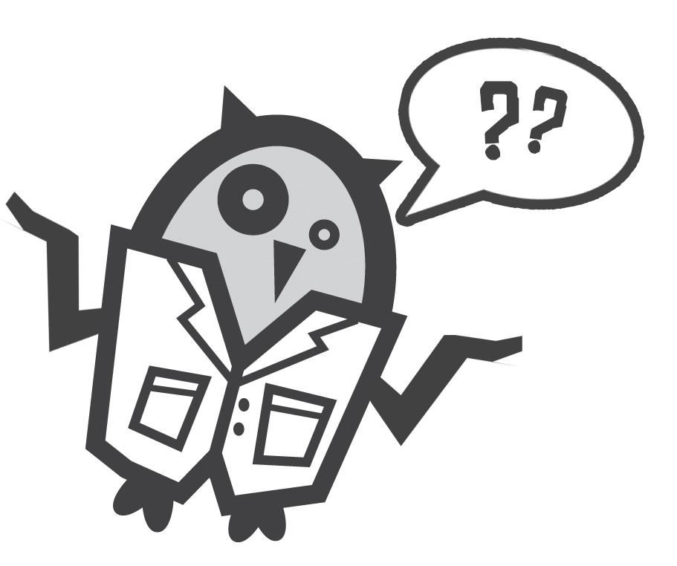
Q&A

Slide 25
Thank You

